Slide 1


Python Programming Summer Camp
Class # 8
Course End Project
By Asim Munawar

Slide 2

Course Plan
Lesson 1: Printing Fun – Say Hello to Python
Lesson 2: Variables – Remembering Things in Code
Lesson 2: If/Else – Making Decisions
Lesson 3: Loops – Doing Things Again and Again / Inputs
Lesson 4: Lists – Collecting Many Things
Lesson 5: Functions – Teach the Computer a New Trick
Lesson 6: Libraries - Using Functions written by others
Files – Saving and Reading Data
Lesson 7: Build an application from scratch
Lesson 8: Final Project – Build and Present Your App

Slide 3

Course End Party
Presentations (5 min)
Certificates
Snacks
Gifts

Slide 4
Rules for Project
✅ What You Can Do
✅ Use anything we learned in class: print, variables, if/else, loops, lists, functions, libraries, and file saving. Feel free to use anything else.
✅ Get help from your parents.
✅ Search Google or use YouTube tutorials for help.
✅ Take inspiration from other code, but write your own version.
✅ Add cool new features, as you wish.
❌ What You Cannot Do
❌ No use of AI tools (like ChatGPT or Copilot).
❌ Don't copy full code without understanding it.
🎯 Presentation
You will do a 5-minute demo of your project in Class 8.
Show how your program works and explain what parts you built.
Be proud — even a small working project is awesome!

Slide 5
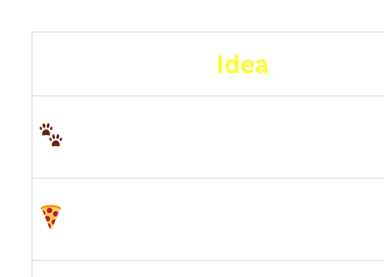
Some Ideas

Slide 6


💡 Idea 1: Pet Logger – Track What Your Pet Did Today!
When the app starts:
Show menu:
1. Add new pet note
2. View all pet notes
3. Exit
If user chooses 1:
Ask for pet name
Ask what they did today
Save answer to a file with today’s date
If user chooses 2:
Read and show all notes from the file
Repeat until user chooses to exit

Slide 7
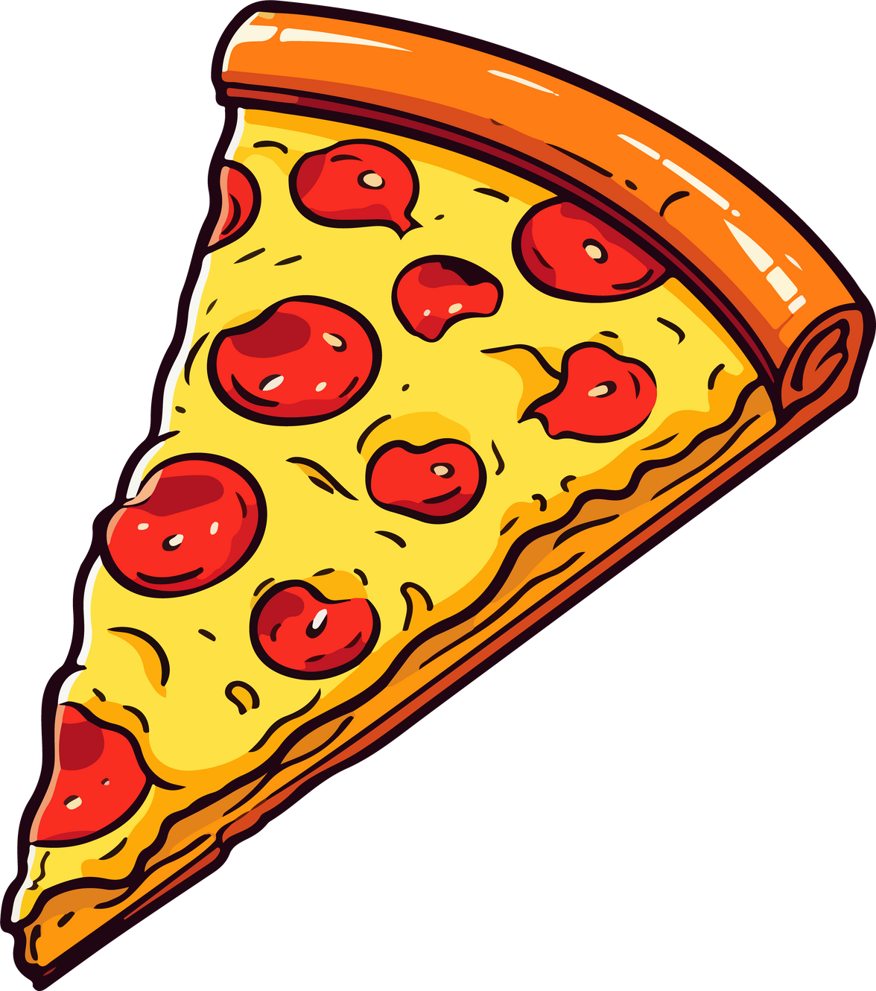
💡 Idea 2: Pizza Order – Make Your Dream Pizza
Start the program:
Say welcome
Ask:
What size pizza? (Small / Medium / Large)
What toppings do you want? (Choose from list)
When done:
Show order summary:
Size and all toppings
Total price (make up any rules)
Ask:
Do you want to order again or exit?
Repeat as needed

Slide 8
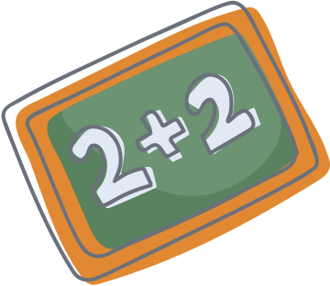
💡 Idea 3: 🧠 Math Quiz – Can You Get All Answers Right?
Start the game:
Set score = 0
Repeat 5 times:
Make a random math question (like 3 x 7)
Show it and ask user to answer
If answer is right:
Add 1 to score
Else:
Say it’s wrong
After 5 questions:
Show final score
Save score and date to a file (optional)

Slide 9
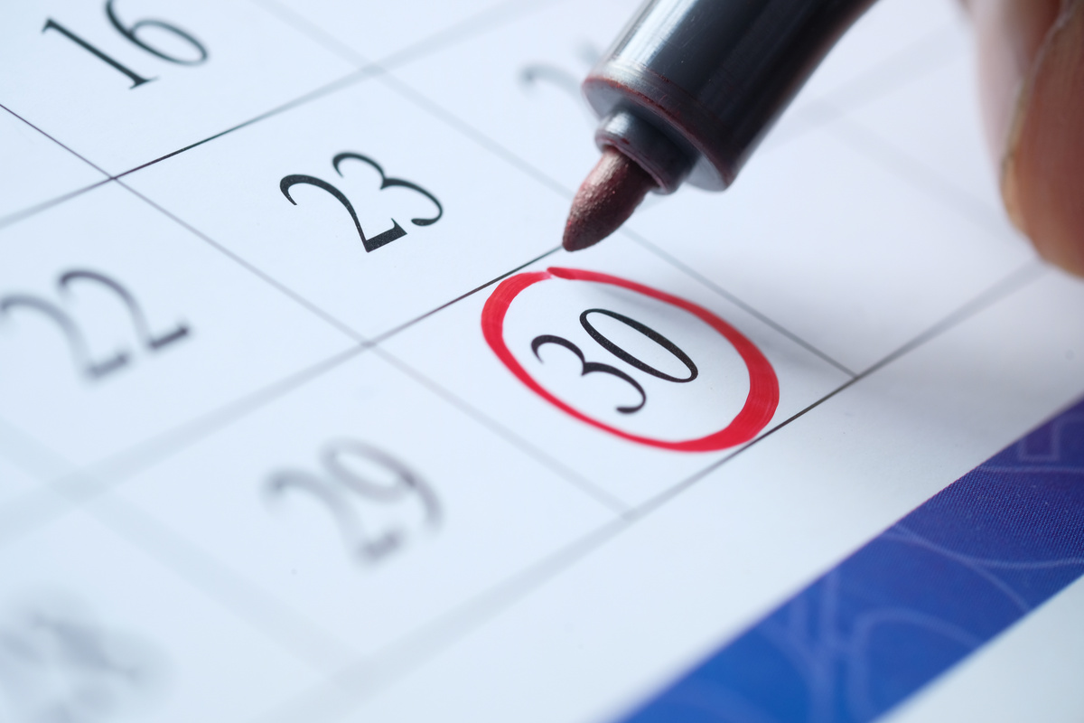

💡 Idea 4: 🎉 Birthday Reminder – Never Forget Again!
Show menu:
1. Add a birthday
2. View saved birthdays
3. Exit
If user chooses 1:
Ask for name
Ask for birthday (date)
Save it to a file
If user chooses 2:
Read and show all saved birthdays
Bonus:
Show how many days left until next birthday
Make it fun by telling time left in seconds

Slide 10

💡 Idea 5: 🧙‍♂️ Choose Your Adventure – Be the Hero!
Start story:
Show opening scene with choices (e.g., “Go left or right?”)
If user chooses left:
Show new scene and more choices
If user chooses right:
Different scene
Keep going for 3–5 choices deep
At the end:
Show ending based on what user chose
Use functions for each scene

Slide 11
💡 Idea 7: Any thing else you want

Slide 12




